Slide 1
Multivariate StatiSTICal Analysis
Factor Analysis

Slide 2
Steps in Factor Analysis: The Correlation Matrix
Factor analysis usually proceeds in four steps:
1st Step: the correlation matrix for all variables is computed
2nd Step: Factor extraction
3rd Step: Factor rotation
4th Step: Make final decisions about the number of underlying factors

Slide 3
Steps in Factor Analysis: The Correlation Matrix
1st Step: the correlation matrix :
Generate a correlation matrix for all variables.
Identify variables not related to other variables.
If the correlation between variables are small, it is unlikely that they share common factors (variables must be related to each other for the factor model to be appropriate).

Slide 4
Steps in Factor Analysis: The Correlation Matrix
1st Step: the correlation matrix :
Think of correlations in absolute value.
Correlation coefficients greater than 0.3 in absolute value are indicative of acceptable correlations.
Examine visually the appropriateness of the factor model.

Slide 5
Steps in Factor Analysis: The Correlation Matrix
Kaiser-Meyer-Olkin Measure of Sampling Adequacy : This measure varies between 0 and 1, and values closer to 1 are better. A value of .6 is a suggested minimum.
Bartlett’s Test of Sphericity : This tests the null hypothesis that the correlation matrix is an identity matrix. An identity matrix is matrix in which all of the diagonal elements are 1 and all off diagonal elements are 0. You want to reject this null hypothesis.

Slide 6
Steps in Factor Analysis: Factor Extraction
2nd Step: Factor extraction
The primary objective of this stage is to determine the factors.
Initial decisions can be made here about the number of factors underlying a set of measured variables.
Estimates of initial factors are obtained using Principal components analysis.

Slide 7
Steps in Factor Analysis: Factor Extraction
2nd Step: Factor extraction
The principal components analysis is the most commonly used extraction method . Other factor extraction methods include:
Maximum likelihood method.
Principal axis factoring.
Alpha method.
Unweighted lease squares method.
Generalized least square method.
Image factoring.

Slide 8
Steps in Factor Analysis: Factor Extraction
In principal components analysis, linear combinations of the observed variables are formed.
The 1st principal component is the combination that accounts for the largest amount of variance in the sample (1st extracted factor).

Slide 9
Steps in Factor Analysis: Factor Extraction
The 2nd principle component accounts for the next largest amount of variance and is uncorrelated with the first (2nd extracted factor).
Successive components explain progressively smaller portions of the total sample variance, and all are uncorrelated with each other.

Slide 10
Steps in Factor Analysis: Factor Extraction
To decide on how many factors we need to represent the data, we use 2 statistical criteria:
Eigen Values, and
The Scree Plot.
The determination of the number of factors is usually done by considering only factors with Eigen values greater than 1.
Total Variance Explained
Component | Initial Eigenvalues |  |  | Extraction Sums of Squared Loadings
 | Total | % of Variance | Cumulative % | Total | % of Variance | Cumulative %
1 | 3.046 | 30.465 | 30.465 | 3.046 | 30.465 | 30.465
2 | 1.801 | 18.011 | 48.476 | 1.801 | 18.011 | 48.476
3 | 1.009 | 10.091 | 58.566 | 1.009 | 10.091 | 58.566
4 | .934 | 9.336 | 67.902
5 | .840 | 8.404 | 76.307
6 | .711 | 7.107 | 83.414
7 | .574 | 5.737 | 89.151
8 | .440 | 4.396 | 93.547
9 | .337 | 3.368 | 96.915
10 | .308 | 3.085 | 100.000
Extraction Method: Principal Component Analysis.

Slide 11
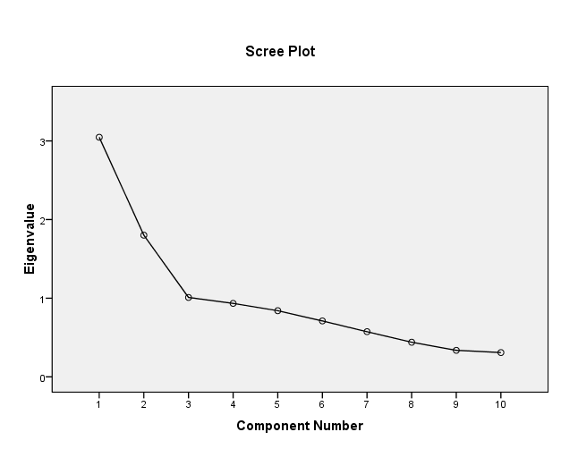
Steps in Factor Analysis: Factor Extraction
The examination of the Scree plot provides a visual of the total variance associated with each factor.
The steep slope shows the large factors.
In choosing the number of factors, in addition to the statistical criteria, one should make initial decisions based on conceptual and theoretical grounds.

Slide 12
Steps in Factor Analysis: Factor Extraction
At this stage, the decision about the number of factors is not final.

Slide 13
Steps in Factor Analysis: Factor Extraction
Component Matrix using Principle Component Analysis
Component Matrixª
 | Component
 | 1 | 2 | 3
I discussed my frustrations and feelings with person(s) in school | .771 | -.271 | .121
I tried to develop a step-by-step plan of action to remedy the problems | .545 | .530 | .264
I expressed my emotions to my family and close friends | .580 | -.311 | .265
I read, attended workshops, or sought someother educational approach to correct the problem | .398 | .356 | -.374
I tried to be emotionally honest with my self about the problems | .436 | .441 | -.368
I sought advice from others on how I should solve the problems | .705 | -.362 | .117
I explored the emotions caused by the problems | .594 | .184 | -.537
I took direct action to try to correct the problems | .074 | .640 | .443
I told someone I could trust about how I felt about the problems | .752 | -.351 | .081
I put aside other activities so that I could work to solve the problems | .225 | .576 | .272
Extraction Method: Principal Component Analysis.
a. 3 components extracted.

Slide 14
Steps in Factor Analysis: Factor Extraction
3rd Step: Factor rotation.
In this step, factors are rotated.
Un-rotated factors are typically not very interpretable (most factors are correlated with many variables).
Factors are rotated to make them more meaningful and easier to interpret (each variable is associated with a minimal number of factors).
Different rotation methods may result in the identification of somewhat different factors.

Slide 15
Steps in Factor Analysis: Factor Extraction
The most popular rotational method is Varimax rotations.
Varimax use orthogonal rotations yielding uncorrelated factors/components.
Varimax attempts to minimize the number of variables that have high loadings on a factor. This enhances the interpretability of the factors.

Slide 16
Steps in Factor Analysis: Factor Rotation
Other common rotational method used include Oblique rotations which yield correlated factors.
Oblique rotations are less frequently used because their results are more difficult to summarize.
Other rotational methods include:
Quartimax (Orthogonal)
Equamax (Orthogonal)
Promax (oblique)

Slide 17
Steps in Factor Analysis: Factor Rotation
A factor is interpreted or named by examining the largest values linking the factor to the measured variables in the rotated factor matrix.
Rotated Component Matrixª
 | Component
 | 1 | 2 | 3
I discussed my frustrations and feelings with person(s) in school | .803 | .186 | .050
I tried to develop a step-by-step plan of action to remedy the problems | .270 | .304 | .694
I expressed my emotions to my family and close friends | .706 | -.036 | .059
I read, attended workshops, or sought someother educational approach to correct the problem | .050 | .633 | .145
I tried to be emotionally honest with my self about the problems | .042 | .685 | .222
I sought advice from others on how I should solve the problems | .792 | .117 | -.038
I explored the emotions caused by the problems | .248 | .782 | -.037
I took direct action to try to correct the problems | -.120 | -.023 | .772
I told someone I could trust about how I felt about the problems | .815 | .172 | -.040
I put aside other activities so that I could work to solve the problems | -.014 | .155 | .657

Slide 18
Steps in Factor Analysis: Making Final Decisions
4th Step: Making final decisions
The final decision about the number of factors to choose is the number of factors for the rotated solution that is most interpretable.
To identify factors, group variables that have large loadings for the same factor.
Plots of loadings provide a visual for variable clusters.
Interpret factors according to the meaning of the variables.

Slide 19
Steps in Factor Analysis: Making Final Decisions
This decision should be guided by:
A priori conceptual beliefs about the number of factors from past research or theory
Eigen values computed in step 2.
The relative interpretability of rotated solutions computed in step 3.

Slide 20
Assumptions Underlying Factor Analysis
Assumption underlying factor analysis include.
The measured variables are linearly related to the factors + errors.
This assumption is likely to be violated if items limited response scales (two-point response scale like True/False, Right/Wrong items).
The data should have a bi-variate normal distribution for each pair of variables.
Observations are independent.
The factor analysis model assumes that variables are determined by common factors and unique factors. All unique factors are assumed to be uncorrelated with each other and with the common factors.

Slide 21
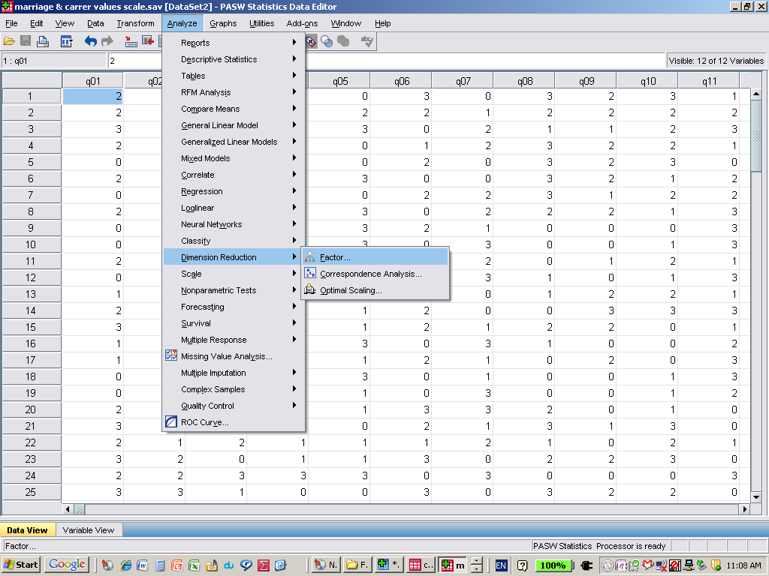
Obtaining a Factor Analysis
Click:
Analyze and select
Dimension Reduction
Factor
A factor Analysis Box will appear

Slide 22
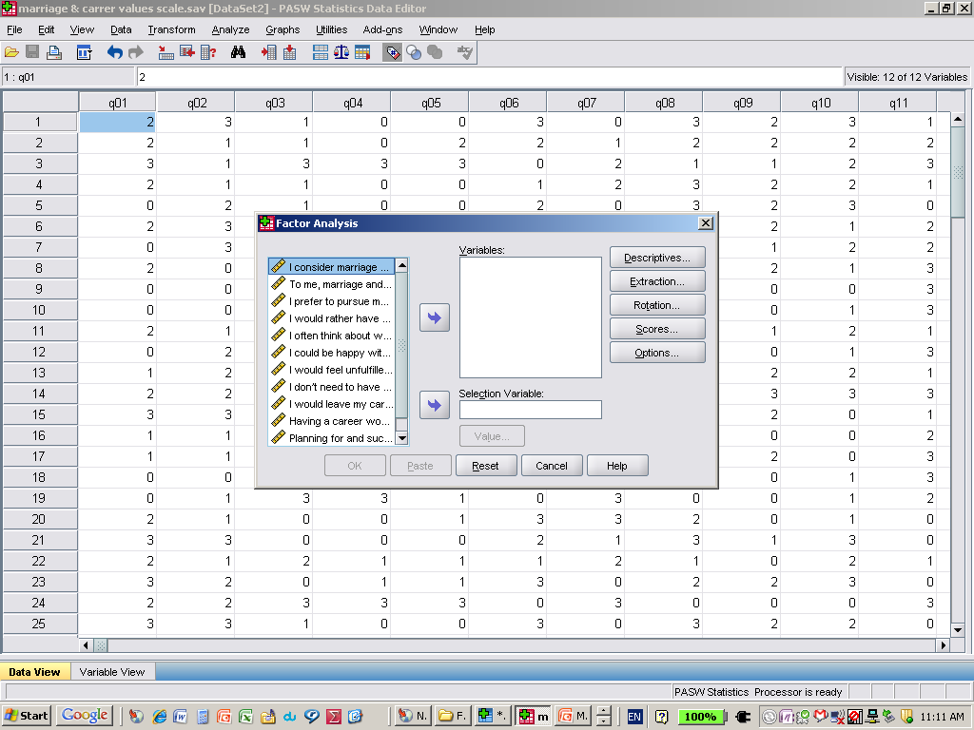
Obtaining a Factor Analysis
Move variables/scale items to Variable box

Slide 23
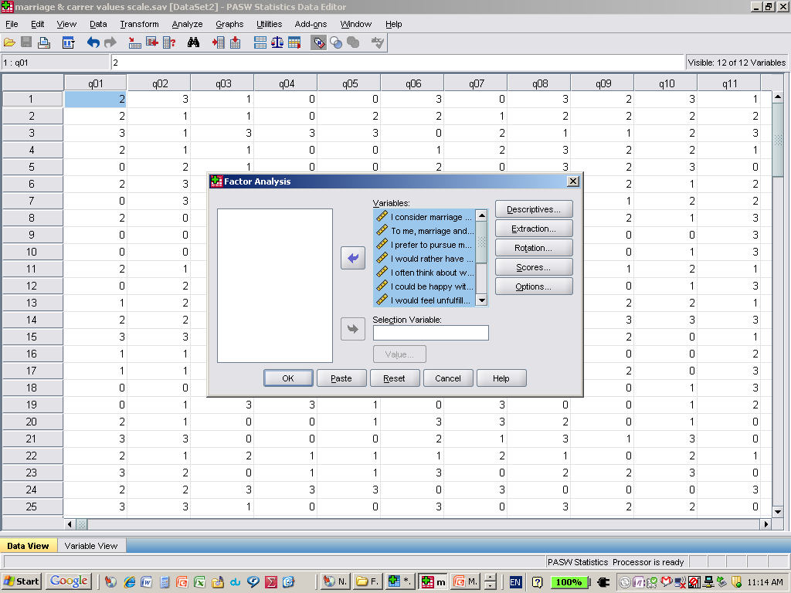
Obtaining a Factor Analysis
Factor extraction
When variables are in variable box, select:
Extraction

Slide 24
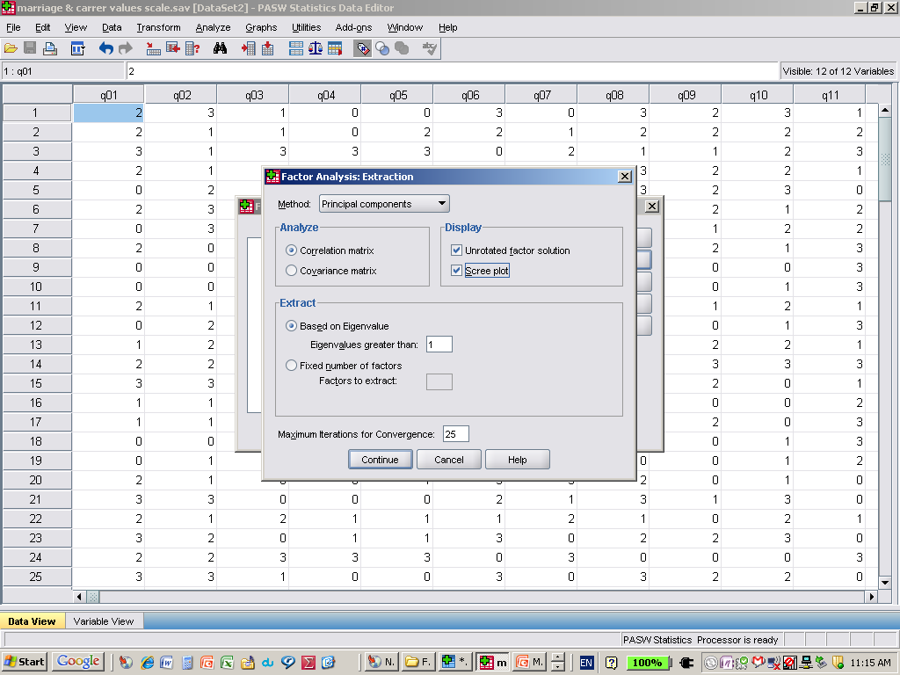
Obtaining a Factor Analysis
When the factor extraction Box appears, select:
Scree Plot
keep all default selections including:
Principle component Analysis
Based on Eigen Value of 1, and
Un-rotated factor solution

Slide 25
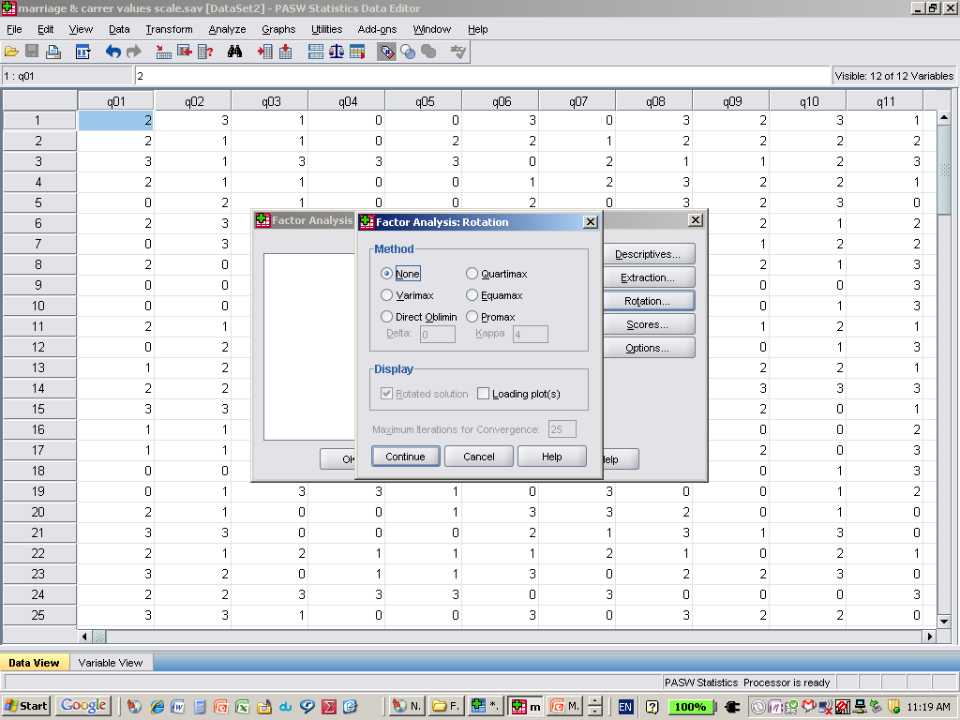
Obtaining a Factor Analysis
During factor extraction keep factor rotation default of:
None
Press continue

Slide 26
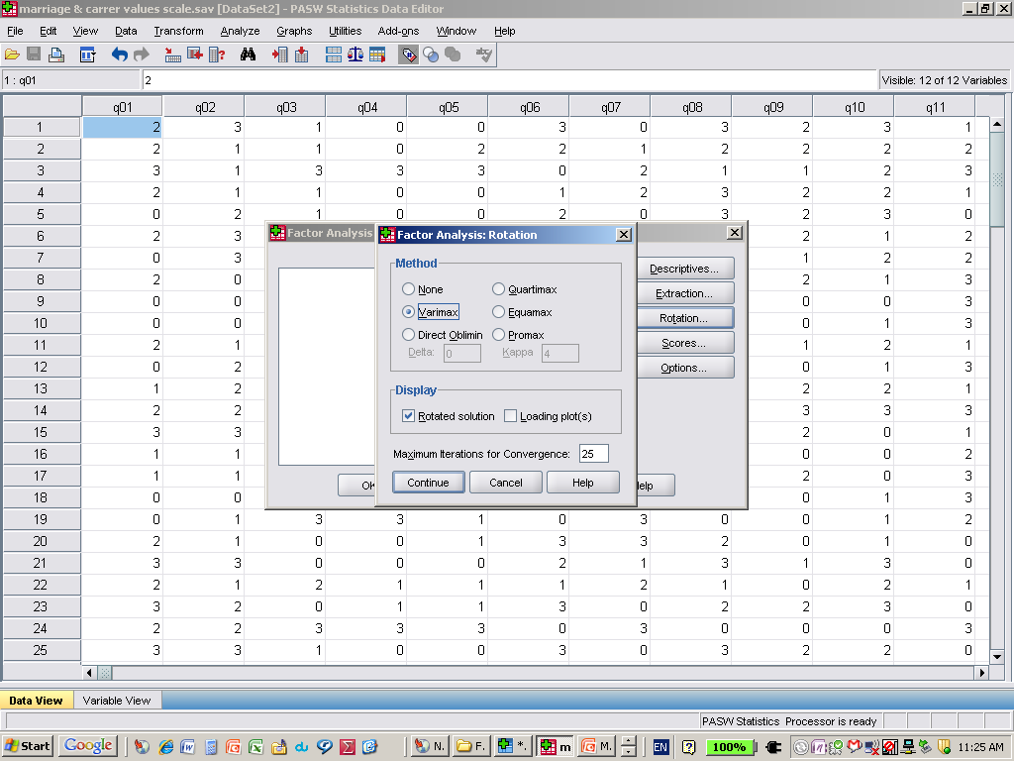
Obtaining a Factor Analysis
During Factor Rotation:
Decide on the number of factors based on actor extraction phase and enter the desired number of factors by choosing:
Fixed number of factors and entering the desired number of factors to extract.
Under Rotation Choose Varimax
Press continue
Then OK

Slide 27
Principal Components methods – Mathematical View
Principal Components Method
First Component can be expressed as a linear combination in responses variables.
Assume we have p of response variables so , the first component will be :
Where aij are loadings of response variables with the first factor.

Slide 28

Principal Components methods – Mathematical View
Principal Components Method
The first component will be :
As we mentioned before , the first component has largest Variation.

Slide 29
Example
Go to SPSS …

Slide 30
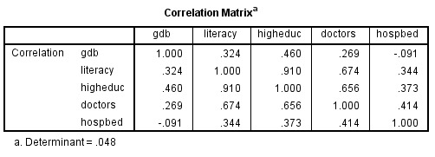
Example

Slide 31
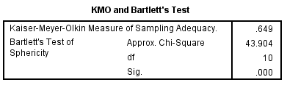
Example

Slide 32
Example
We note that KMO measure is 0.649 and it is adequate.
We note that we can reject Bartlett's Test of Sphericity
H0 : Correlation matrix is an identity matrix.
H1 : H0 is not correct.

Slide 33
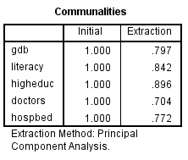
Example

Slide 34
Example
The previous table express the Communalities.
Extracted Communalities for each variable were explained in the last right column.
Communality is between (0-1) .
Ex: the communality for GDB refer that 0.797 of variance in GDB was explained by the factor extracted.
In Component matrix ((0.477)^2 + (0.754)^2 = 0.797)
Generally, extracted factors interpret a high percentage of variables variance

Slide 35
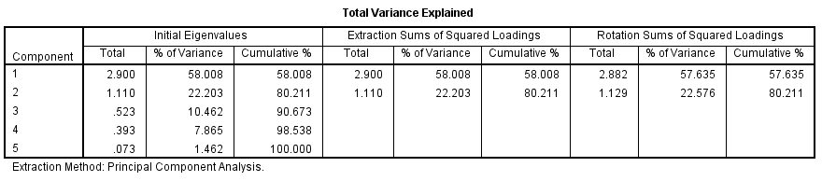
Example

Slide 36
Example
Total Variance explained is 80.211 , the first factor has a highest eigenvalue (2.9) and explained variance (58%).
The second factor has an eigenvalue 1.11 and explained variance 22.576%.
Variance explained by the 1st factor = (Eigenvalue for the 1st fact / No. of all eigenvalues) * 100 = (2.9/5)*100 = 58%.
Variance explained by the 2nd factor = (Eigenvalue for the 2nd fact / No. of all eigenvalues) * 100 = (1.11/5)*100 = 22.2%.

Slide 37
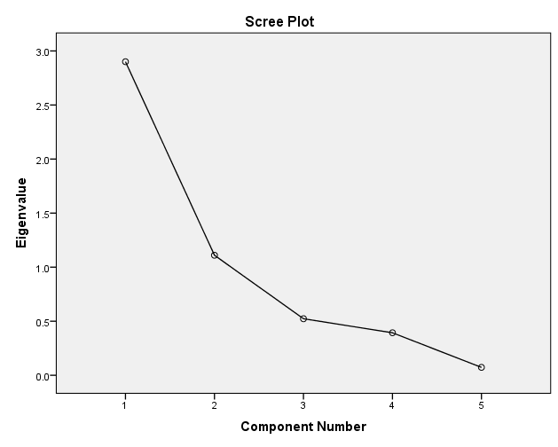
Example

Slide 38
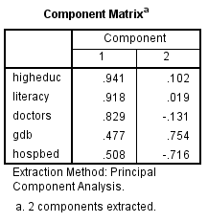
Example

Slide 39
Example
The previous table shows the component matrix which include LOADINGS of the two factors extracted.
Loadings : is the simple correlation coefficient between factor and variable.
From component matrix the Highest correlated variable with the 1st factor was “higheduc” where factor loading with the variable “higheduc” was 0.941.
Then “literacy” with 0.918 then “doctors” with 0.829

Slide 40
Example
From component matrix the Highest correlated variable with the 2nd factor was “gdb” where factor loading with the variable “gdb” was 0.754.
Then “Hospbed” with -0.716 then “doctors” with -0.131
Note:
The communality of variable is sum of squares of loadings of variable with extracted variables.
Communality of “gdb” = (0.477)^2 + (0.754)^2 = 0.797.

Slide 41
Example
The sum of squares of variable loading with the factor (factor loading) equal the eigenvalue of the factor , for instance :
The eigenvalue of the 1st factor = (0.477)^2 + (0.918)^2 + (0.941)^2 + (0.829)^2 + (0.508)^2 = 2.9
CHECK the eigenvalue of 2nd factor ???

Slide 42
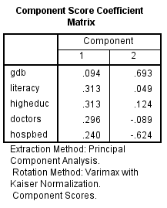
Example

Slide 43
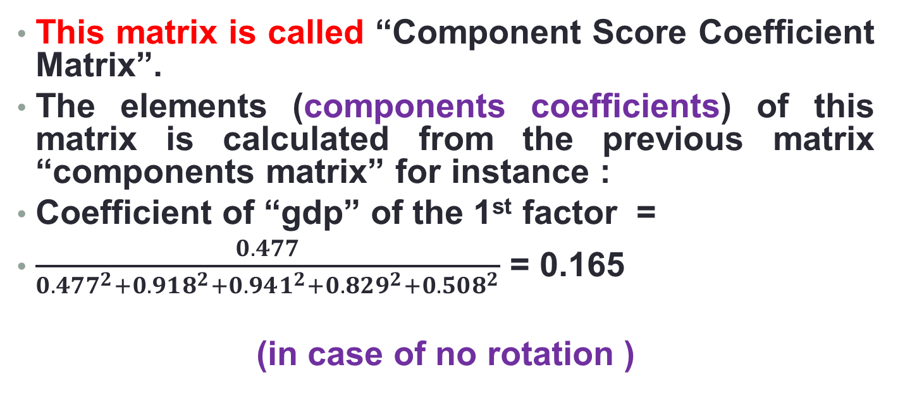
Example
This matrix is called “Component Score Coefficient Matrix”.
The elements (components coefficients) of this matrix is calculated from the previous matrix “components matrix” for instance :
Coefficient of “gdp” of the 1st factor =
$\frac{0.477}{0.477^{2}+0.918^{2}+0.941^{2}+0.829^{2}+0.508^{2}}$ = 0.165
(in case of no rotation )

Slide 44
Example
Finally we can write the equation for two factors :
Fac_1 =0.094*gdb+0.313*literacy + 0.313*higheduc + 0.296*doctors + 0.240*hospbed
(in case of there is a rotation)
Fact_2 = ???
Assignement 1 – examine how to get the component score coefficient matrix in case of there is a rotation.

